Slide 1
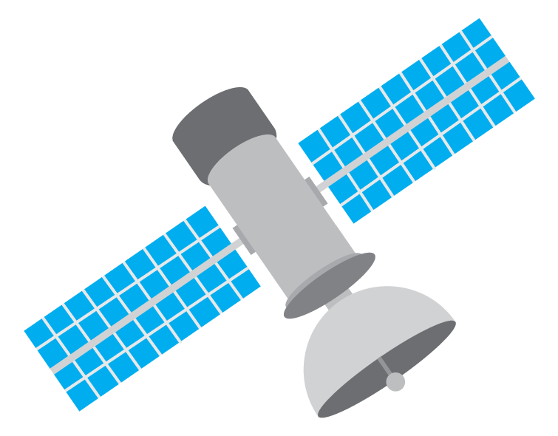

Slide 2
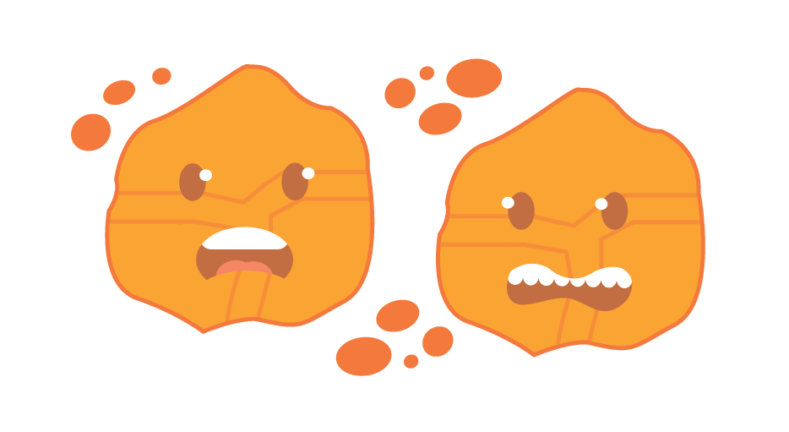
What is a Harmful Algal Bloom (HAB)?
HABs occur when colonies of algae — simple plants that live in the sea and freshwater — grow out of control and produce toxic effects on people, animals or ecosystems.
Florida experiences different types of HABs such as:
Red tide: caused by algal species Karenia Brevis; occurs along coast.
Blue-green blooms: caused by bacteria species; occurs in freshwater.

Slide 3
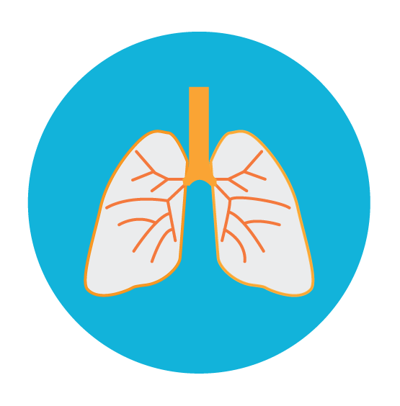
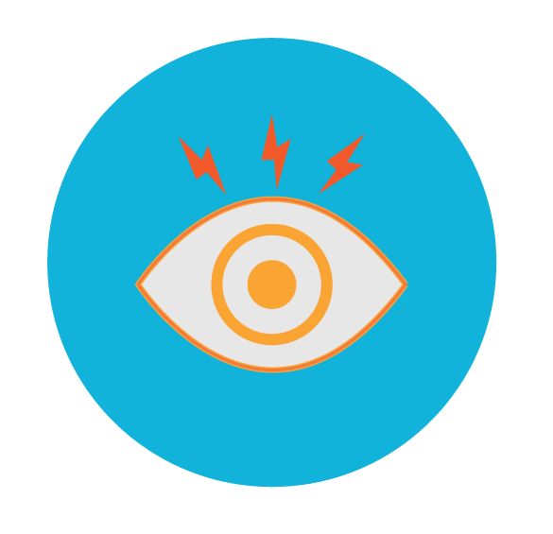
Symptoms of HAB exposure
HABs produce toxins that can be detrimental to the health of humans, pets, livestock and wildlife.
Potential symptoms of HAB exposure include:
Respiratory irritation
Itchy/ irritated eyes
Skin rashes

Slide 4
Tracking HABs via satellite imaging
High concentrations of plant pigments in algal blooms produces a visible color change in water.
This color change can be detected by satellites in the Earth’s orbit.
Most ocean color imagery uses a color palette ranging from purple to red as algae concentration increases.

Slide 5
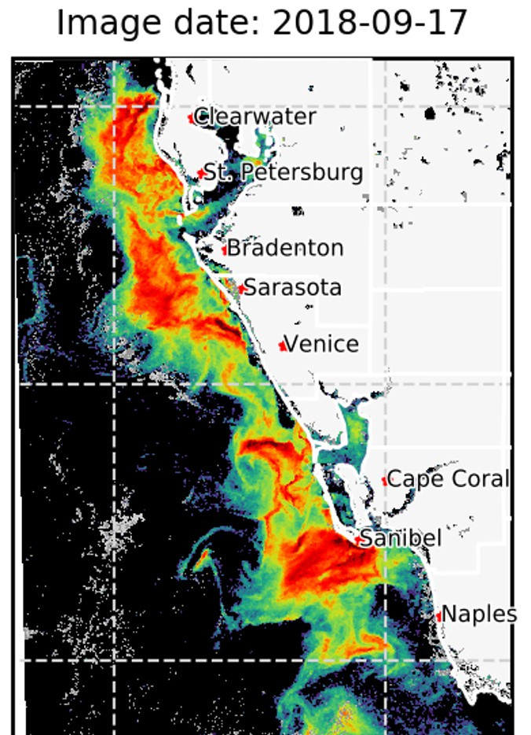
Satellite images of HABs in Florida
High concentrations of K. brevis during a red tide event pictured off Florida’s west coast in 2018.

Slide 6
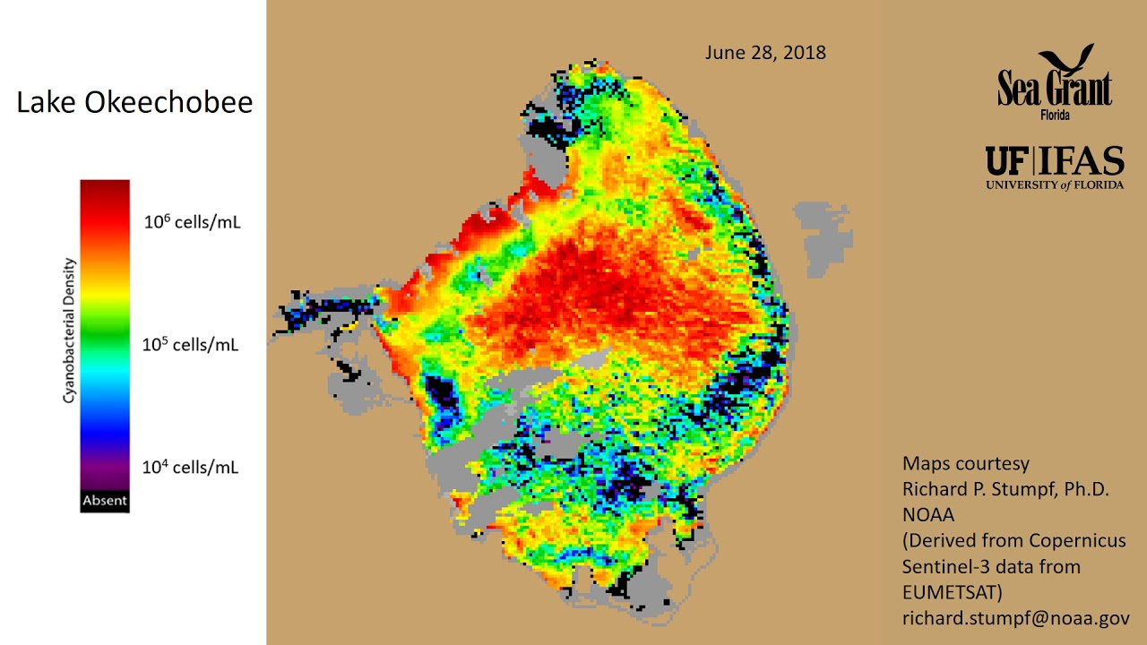
Satellite images of HABs in Florida
High concentrations of blue-green algae pictured in Lake Okeechobee in 2018.

Slide 7
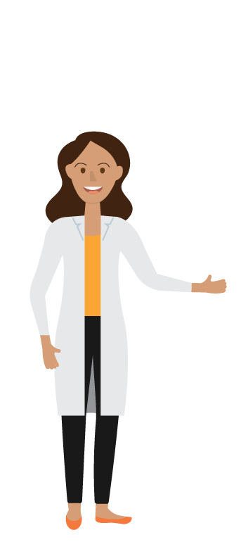
How do scientists track HABs?
Benefits of satellite imaging:
Satellites cover larger areas than a person could on the water.
Satellite images are more sensitive than the human eye.
Satellite images tell scientists how large a bloom is and what direction it is heading.

Slide 8
Limitations
Satellite data does not identify what species of algae is responsible for the change in water conditions.
Water conditions right along the coast are difficult to distinguish.
The first pixel in satellite images is a mix of land and water, which can distort information.
Smoke or smog on land can make accurate readings of the coast difficult.
In order to determine if a bloom is harmful, scientists must combine satellite images with field samples.

Slide 9
HABscope Forecasts
Along the Gulf Coast of Florida, K. brevis red tide respiratory forecasts are produced using satellite imaging by the Gulf of Mexico Coastal Ocean Observing System (GCOOS).
Forecasts are communicated to the public in near real-time, projected over 24 hours and updated with the latest wind models every 3 hours.
VISIT:
https://habscope.gcoos.org

Slide 10
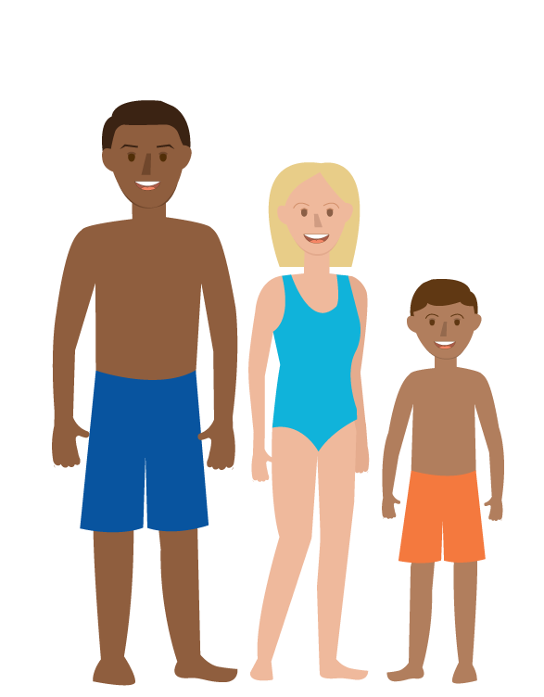
How to use HAB forecasts
HAB forecasts can be used the same way as weather forecasts— to plan beach walks, waterfront dining and other outdoor activities.
Citizens can use HAB forecasts to make informed decisions when visiting an area experiencing a bloom.

Slide 11
HAB Resources
For more information and resources related to HABs in Florida, visit https://www.flseagrant.org/habs/

